Slide 1
Entrepreneur of the Future
Raiha (SMM Intern)
Mudasir (Tech Intern)
Usman (Management Intern)
Faizyab (Tech Intern)
Group 11:

Slide 2

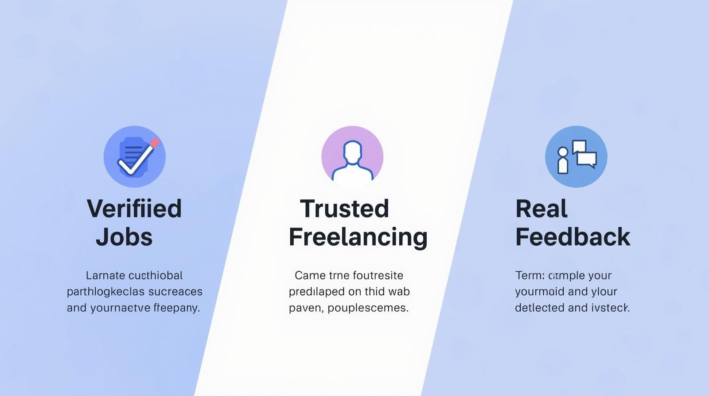
Freelinx
Verified Jobs
Trusted Freelancing
Real Feedback

Slide 3
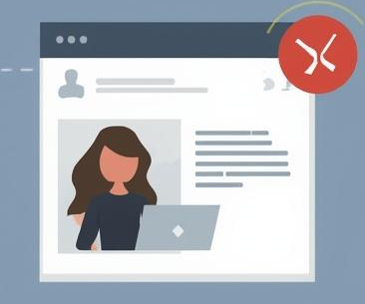

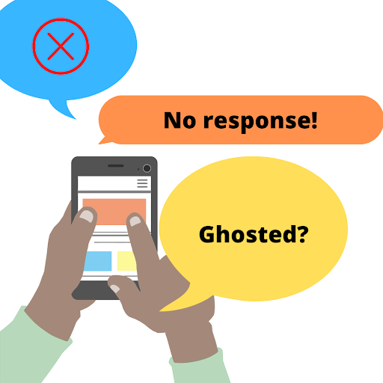

The Problem
Fake profiles & scam postings
Ghosting by companies/clients
No actionable rejection feedback
Overcrowded & irrelevant listings

Slide 4
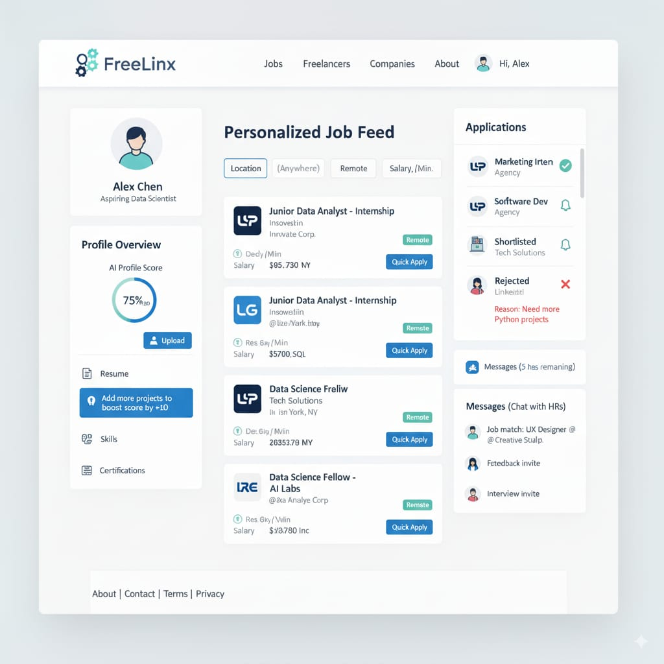
The Solution (Freelinx)
Verified profiles (Email, LinkedIn, ID)
AI Profile Score (0–100)
Transparent rejection feedback
Verified-only reviews
Anti-ghosting rule (7 days)
Wireframe Mockup

Slide 5
Mission & Vision
Mission:
Create a trusted platform with verified opportunities & AI career growth
Vision:
End rejection uncertainty → clear feedback + career insights for every applicant

Slide 6
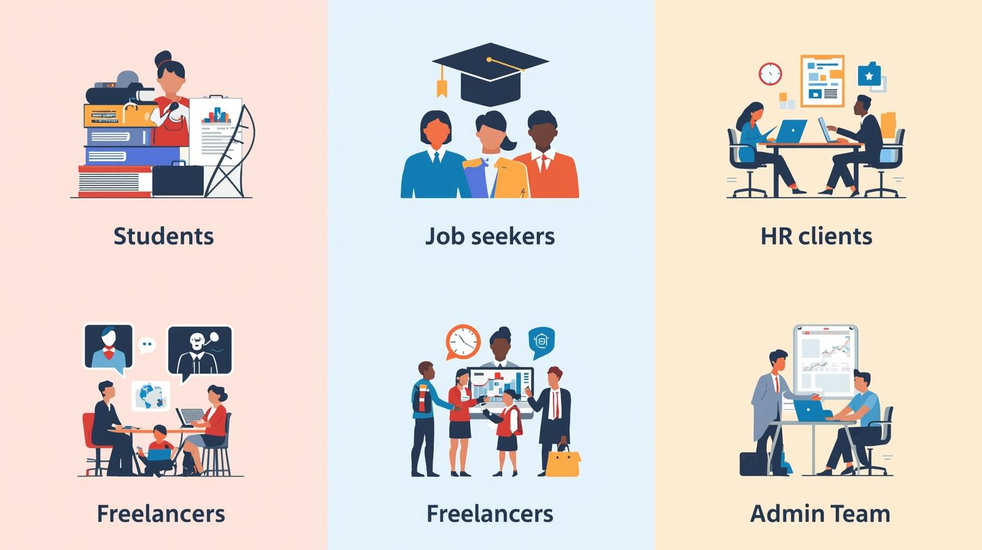
User Types
Students & Job Seekers
HR & Companies
Freelancers
Clients
Admin (Freelinx Team)

Slide 7

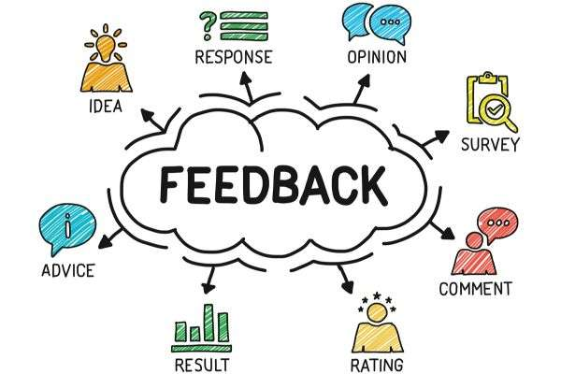
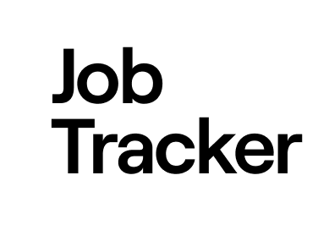
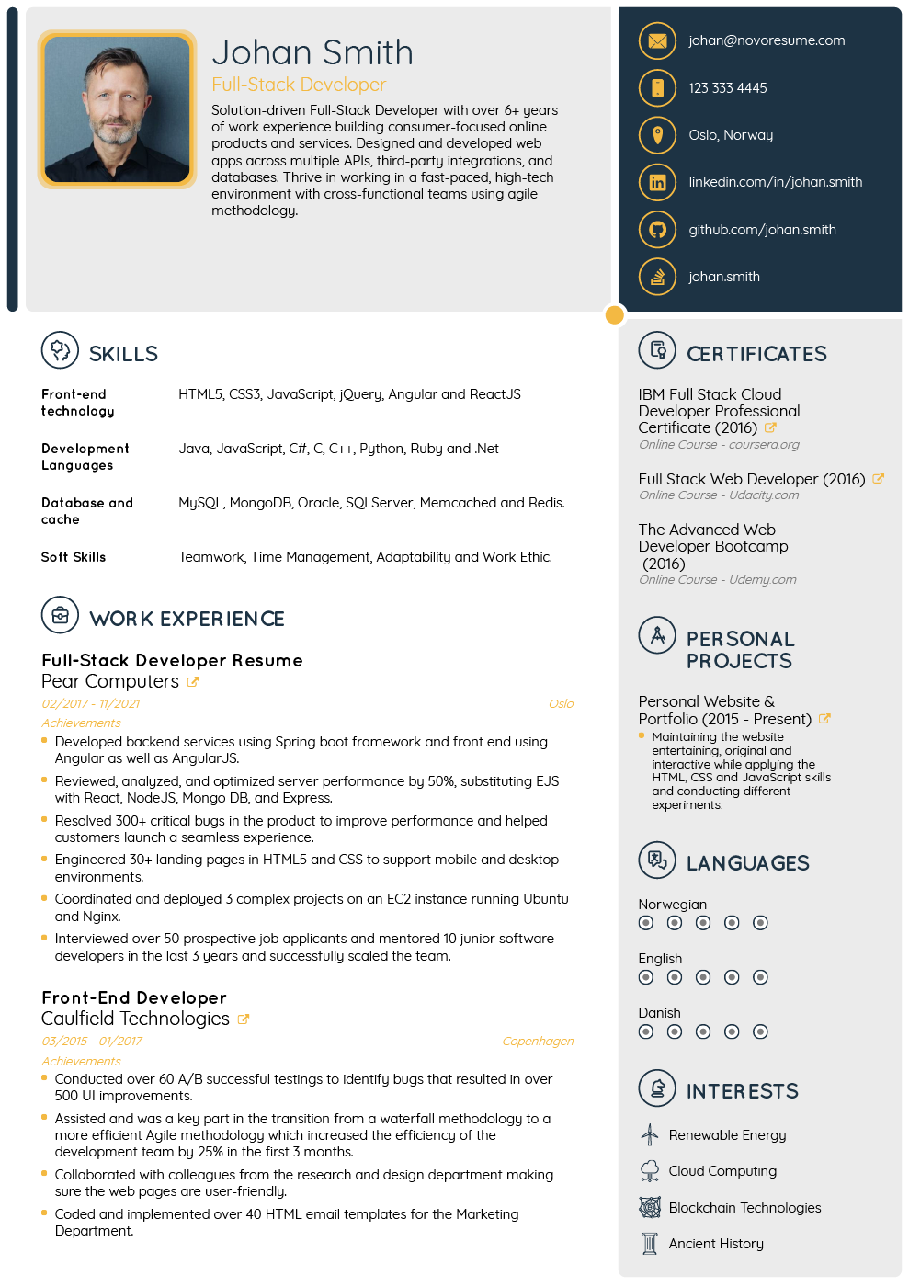
Students / Job Seekers
Verified profiles + AI scoring
Resume, skills & certifications
Personalized job feed
Track applications (applied, shortlisted, rejected)
Feedback from HRs

Slide 8
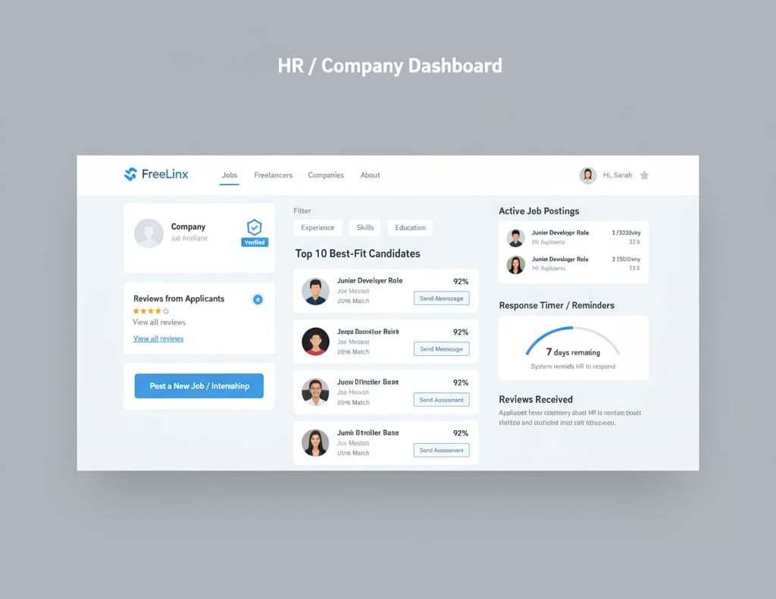
HR & Companies
Verified company profiles
Post jobs/internships
Smart candidate ranking + filters
Send assessments/quizzes
Anti-ghosting reminders
Rated by applicants
Wireframe Mockup

Slide 9
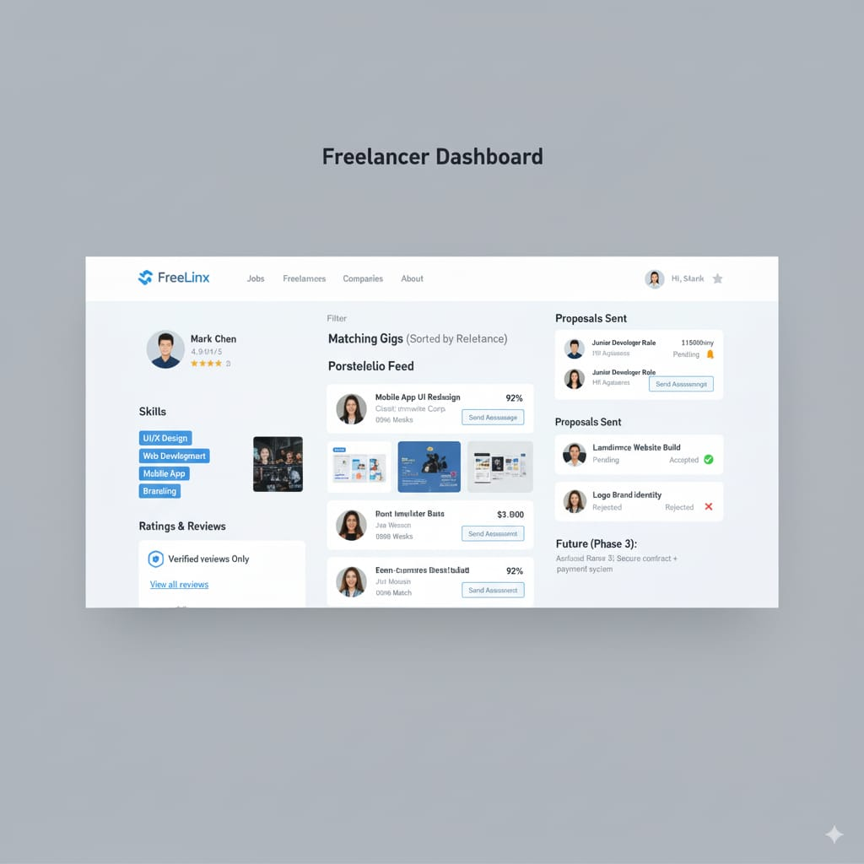
Freelancers & Clients
Freelancers:
Portfolio + AI-matched project feed
Proposal tracking • Verified reviews
Secure contracts + payments
Clients:
Post projects (budget, timeline)
Ranked freelancer list
Hire + chat
Verified reviews
Wireframe Mockup

Slide 10
AI Features
AI Features
Profile Strength Scoring
Smart job/project matching
Learning recommendations (future
Rejection insights + skill gap analysis
Profile Strength Scoring
Smart job/project matching
Rejection insights + skill gap analysis
Learning recommendations (future e-learning partners)

Slide 11

Security & Verification
Multi-layer user verification (Email, LinkedIn, ID, sample projects)
Company verification (official docs, domains, LinkedIn pages)
Data privacy → encrypted + restricted access
Fraud/Scam detection AI

Slide 12
Growth Vision
• Verified internships • Student focus • Uni partnerships
• Secure contracts • AI interview practice tools
• Global hub • AI career advisors • Block chain certificates
Short-Term (1–2 yrs):
Medium-Term (3–4 yrs):
Long-Term (5+ yrs):

Slide 13
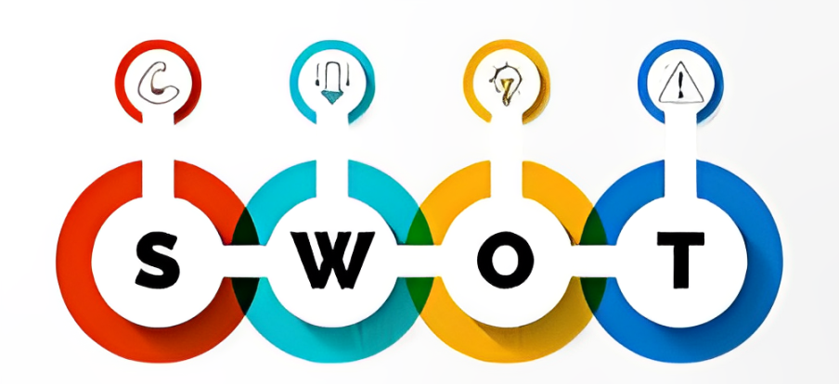
Market Analysis (SWOT)
Strengths:
Verified ecosystem • AI feedback • Multi-segment platform Weaknesses:
New brand • High marketing costs • AI investment Opportunities:
Rising freelancing demand • University partnerships • AI adoption Threats:
LinkedIn/Upwork competition • Cyber security risks • Adoption hesitation

Slide 14


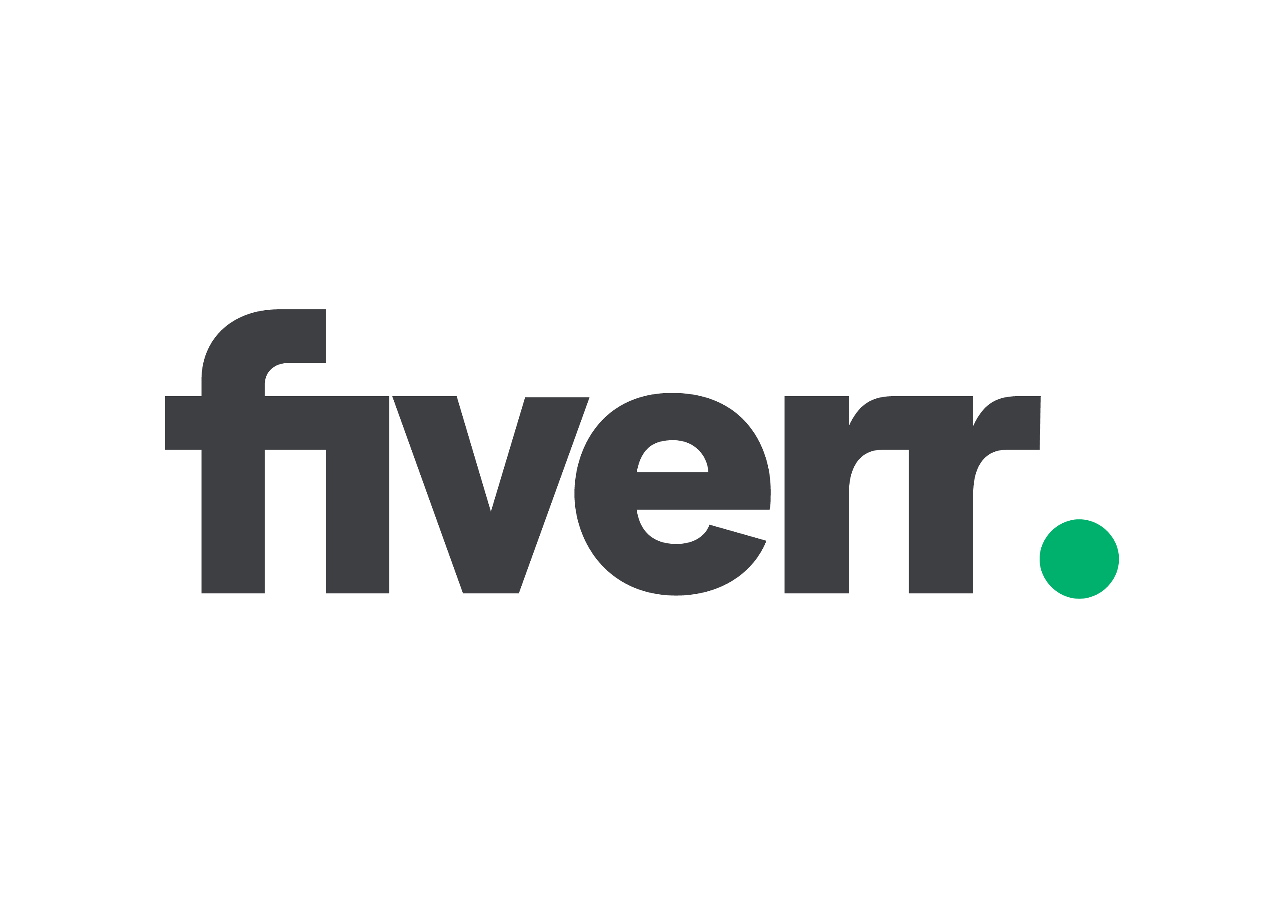


Competitor Landscape
LinkedIn/Indeed:
No feedback, fake postings Upwork/Fiverr:
Expensive, unreliable reviews Rozee.pk/Glassdoor:
Limited scope, no AI tools Freelinx Wins: Verified ecosystem • Real feedback • Free communication • Multi-segment

Slide 15

Target Audiences
Students & Fresh Graduates (18–26)
Job Seekers & Professionals (22–35)
Freelancers (20–40)
HRs & Companies (28–50)
Clients (25–55)
Values:
Trust • Fairness • Growth • Transparency • Innovation

Slide 16
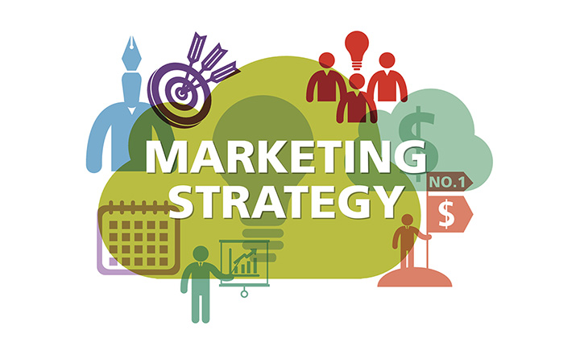
Marketing Strategy
Phase 1 (Launch):
#NoMoreGhosting • Uni partnerships • Influencers • Free trials Phase 2 (Growth):
Referrals • Blogs/YouTube • Ads • HR workshops • Gamification Phase 3 (Expansion):
Premium subs • Partnerships (Coursera/Udemy) • AI services

Slide 17
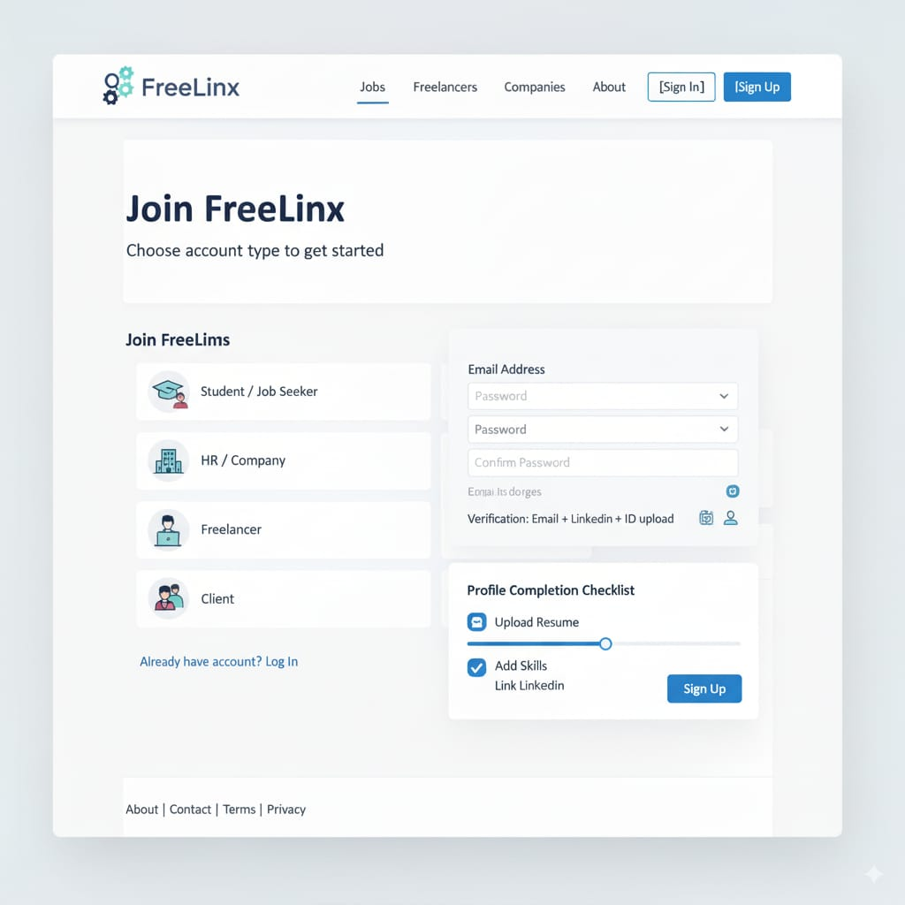
Wireframe & Closing
Web & Mobile App mockups (visuals)

Slide 18
Conclusion
Freelinx is designed to bridge the gap between applicants, freelancers, companies, and clients by offering a verified, scam-free platform with AI-driven feedback and transparent communication. Unlike existing platforms, Freelinx not only connects people to opportunities but also helps them understand rejection reasons, improve their profiles, and grow in their careers, making it a trusted ecosystem for both hiring and freelancing.
Regards,
Thank you

